Slide 1
Empowering Legal to Automate Processes
CHECKBOX BUSINESS CASE
[Company Name]
[INSERT COMPANY
LOGO]

Slide 2
Executive Summary
The Business Problems | The Business Solution
1. Manual Processes – Manual workflows, document generation and execution of legal tasks create inefficiencies and a slower path for the business to realise revenue. 2. Legal Overspend – The legal function spends too many resources on low value, low risk legal work resulting in poor allocation of resources 3. Risk Leakage – Manual intake and triage impacts the ability of the legal function to manage risk and unexpected disruption 4. Absence of Metrics/KPIs – No visibility or inability to report the team's legal activities | Checkbox Standard Base Licence + Dashboards + Single-Sign-On (SSO)
Current monthly business cost: $1,744,166.67* | Checkbox monthly business cost: $2,916.67
*See ROI Calculator Page 9
The ROI and Business Outcome:
Improved ROI – For teams of our size and maturity, Checkbox customers have an average of $613,000.00 Net ROI (Investment Savings)
Faster execution - higher business and legal productivity from digitised processes and automation
Better management – reports and dashboards allow easy oversight of legal tasks and contracts
More cost-effective legal function - increased efficiencies enable lower legal function headcount & external spend
Risk Reduction – by making it easy for the business to get contracts, advice, approvals and signatures, Checkbox customers greatly increased risk management

Slide 3
Checkbox Business Impact Breakdown
Challenges to Overcome | Impacts On Business | Checkbox Solution
Lack of Time The legal team is buried under low risk and high volume legal tasks Slow turnaround times by the legal team | Business Risk: Legal can be a bottleneck for execution of key transactions, slowing down the business’ ability to achieve key objectives Productivity: by having lawyers work on low risk tasks means they can’t spend time on more strategic work Governance Risk: people don’t come to legal because it is too hard / takes too long | Self-Service Automation – Automate routine tasks and agreements (e.g., NDA, service agreements, delegation of authority), allowing the business to self-serve their most used contracts without joining the legal queue, but still with legal control and oversight
Manual Workflows Manual approval and signature processes Inefficient intake, triage and briefing | Cost: inefficient, manual processes take too much time, costing the business money Contract Risk: Business briefing and re-briefing to legal results in business risk and constant redrafting Poor Governance: Lack of oversight and manual approach to contracts delays the business and creates risk | Digitised Approval and Signature Workflows – Request and action approvals and signatures from any device Audit log and record keeping – Searchable digital record of requests, actions, comments and decisions Automated intake and triage – Direct business users seeking help to the appropriate self-help tool, standard advice, or person to improve resource allocation and response times
Inadequate Reporting No visibility over legal tasks Inefficient or incomplete reporting | Business Risk: Manual approach to legal tasks exposes the business to risk due to unknown unknowns No Performance Measurement: We don’t have any KPIs resulting in ‘opaque’ measurement of legal value Lack of transparency: Manual approach means that business partners have to chase legal for updates, resulting in disruptions and delays | Automated data capture – All data and interactions are captured and made available Analytics Dashboard – Measure and visualise data on legal activities to better manage performance and communicate value and resourcing requirements Work status and search – Management dashboards that make it easy to find and better manage work and contracts

Slide 4

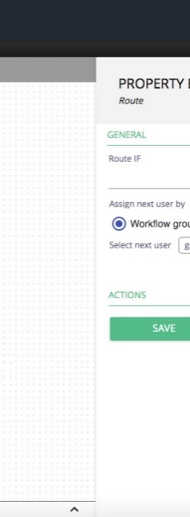

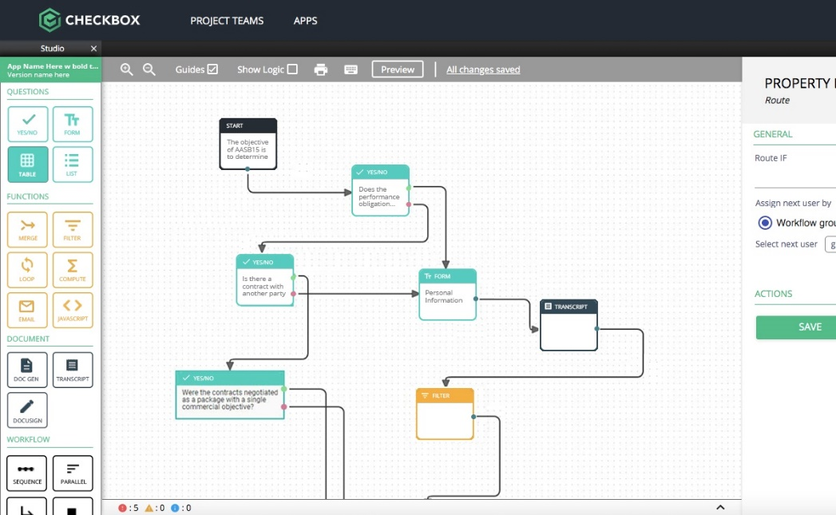

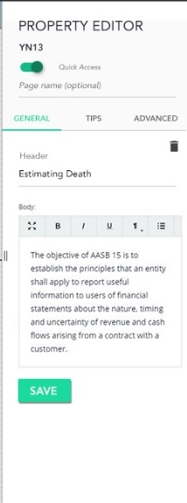

The Solution
No Code Automation
A single platform to automate processes and service delivery in hours, not months using a drag and drop studio.

Slide 5






Checkbox
Capabilities
Forms Automation
Decision Support
Capture the information you need from users or systems and conduct triage using smart forms.
Design complex rules and decision-tree logic, including calculations and weighted scores.
Features anyone can use
Checkbox is the only platform which provides a full suite of enterprise-grade app development features on a single seamless interface.
Workflow Automation
Document Generation
Automate end-to-end user journeys including approvals, scheduled tasks and reminders.
Generate ready-to-go documents, pre-filled and tailored from styled templates with e-signature.
Data Management
No-Code Development
Record, retrieve and update data from dynamic systems of record that connect with your Checkbox Apps.
Prototype, build & maintain applications without IT-skills using our drag-and-drop interface.

Slide 6


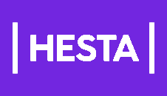
Challenge:
Challenge:
Challenge:
High volume of low value and repetitive work taking up significant lawyer time.
Needed an intake and triage solution allowing business users to self-serve requests and streamline and structure of incoming queries.
Legal team was overloaded with numerous manual tasks including:
  Population and drafting of documents,
  Approval workflows,
  Inter-department communications.
They sought a “build it yourself” platform that empowered SMEs to rapidly automate processes without reliance on IT or external vendors.
HESTA’s rapid growth prompted the need for a more mature system and procurement process.
With no dedicated and centralised procurement function, procurement team were unable to achieve consistency, rigor and clear understanding across the entire organisation on how to procure goods and services.
Solution:
Solution:
Solution:
Case Studies
With Checkbox, they created Engage Legal application - an automated decision tool that triages legal services requests to enable business users to quickly and effectively determine the appropriate legal support that they require.
With Checkbox, they built a digital business application that codified the procurement rules and frameworks automating all data intake, relevant email notifications, reminders and approvals.
The tool guided users through a ‘choose your own adventure’ journey via the compliant-by-design procurement process.
Coca-Cola used Checkbox to automate the documents and cross-functional processes in a fraction of the time needed for traditional IT projects.
Outcomes
Outcomes within the first 6 months
Outcomes within the first 6 months
Over 6,000 hours per annum saved across all apps developed.
Lawyers spend less time on menial tasks and more time on strategic work.
350+ Bespoke Employee Letters Automated
1,000+ Documents Generated
15+ Workflows Automated
793+ Hours Saved Across the Entire Organization
Consolidation of multiple policies in a single tool

Slide 7
Use Cases That Lend Itself to Checkbox
Checkbox is used to address any of the following use case types individually or in combination.
Type of use-case | Description
Automated advice Policy, Q&A, delegation of authority/approval | Checkbox allows the creation of apps which codify existing manual processes and policies which increases adoption and ensures compliance by design. Low barrier to entry means that apps can be created for situations that wouldn’t otherwise be digitized.
Approval workflows Procurement, contract review, reimbursement | Checkbox allows workflows involving multiple touchpoints (intake, approvals, document reviews) across the entire organisation to be digitised. This dramatically reduces turnaround time and increases visibility. The flexibility of Checkbox also allows workflows to be changed easily as you discover what works best.
Weighted risk assessments Privacy, safety, claims, ethics and compliance | Checkbox can be used to assign weightings to various factors during a process to arrive at a classification or assessment outcome. Different risk weightings can drive different workflow paths, different documents, and different conclusions. This drives standardisation of risk appetite and focuses experts on the risk factors, rather than grappling with the underlying business rules.
Intake and triage Incoming work and enquiries | Checkbox can automate the triage process for incoming work and enquiries. A self-service triage of intake means a faster turnaround for the business whilst dramatically reducing the amount of work of support teams.
Document generation and notifications NDAs, trial agreements, letters, T&Cs, justification notes | Checkbox can deliver standardised outputs (advice, letters, contracts, emails, etc.) and can delivered fully completed, direct to the business user. Outputs can also be delivered as partially completed to the expert to apply their expertise on the “grey areas”.

Slide 8
Initial Use Cases Identified For [Insert Company Name]
App Name | Description | Benefits
[Use-case 1] The same type of automation can be applied to many more standard documents and agreements such as pilot agreements and simple services agreements. | EXAMPLE Problem NDAs are low risk documents that are required across the business but consume valuable lawyer time to administer. Non-disclosure agreements often precede commercial discussions and therefore act as a bottleneck to the business progressing deals when waiting on legal. EXAMPLE Solution Self-service tool for business users to generate their own non-disclosure agreements complete with e-signature. | Quicker turnaround time for the business to receive an NDA which shortens the time to doing business. Reduced risk of error through pre-population and validation of fields (e.g. business number look-up). Reduced compliance risk due to centralised management of NDAs with digital audit trail. Free up lawyers to focus on higher value, more enjoyable work.
(2) [Use-case 2] | EXAMPLE Problem When entering into new contracts or agreements with third parties business needs to undertake various risk assessments. These are administered by Risk, Privacy and Cybersecurity teams with many of the questions overlapping resulting in repeated entry of the same information and double handling. It is currently not very clear when these assessments need to be performed and they are not strictly enforced or tracked, which increases the risk of breaching compliance requirements. Further, given the limited headcount, it is estimated that only 10% of risk assessments are conducted due to lack of capacity, resulting in a low coverage. EXAMPLE Solution Risk assessment tool that facilitates the assessment and approval workflow across Risk, Privacy and Cybersecurity with automatic notifications and a digital audit trail that tracks and provides visibility over risk assessments across the business. | Reduce work through self-serve 'right the first time' information. Single input of information to reduce unnecessary work due to overlap or double-up. Reduction in financial and reputational risk. Improve timeliness of contracting for the business. Greater visibility to the Board over non-financial risk reporting. Checkbox has been used by other enterprises to digitise similar processes before and can provide expertise around this.

Slide 9

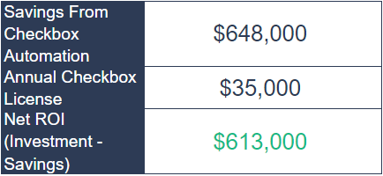
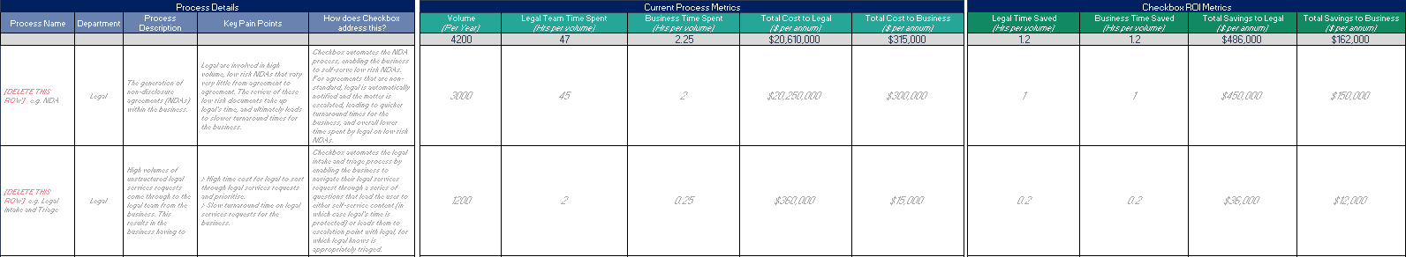
ROI for [Company Name]
You can access the link to the ROI Calculator used here:
[insert accessible link]
Return on Investment

